Slide 1
Sequential Circuits
Flip-Flops and Counters

Slide 2
Sequential Circuits
Output depends on current value as well as past value of inputs.
Sequential circuits also include storage elements i.e. have “memory” property.
It consists:
Combinational circuit
Feedback circuit or storage unit

Slide 3
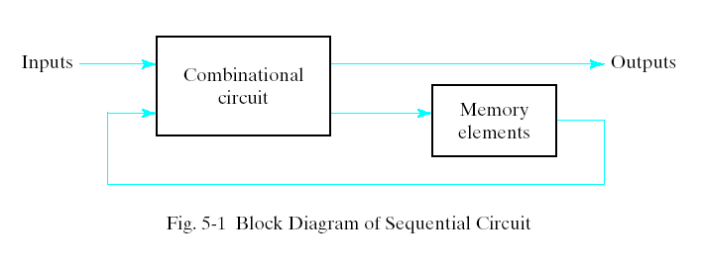
A sequential circuit may use many flip-flops to store as many bits as necessary. The outputs can come either from the combinational circuit or from the flip-flops or both.

Slide 4
Flip Flop
A flip flop is a binary storage device. It can store binary bit either 0 or 1. It has two stable states HIGH and LOW i.e. 1 and 0.
It has the property to remain in one state indefinitely until it is directed by an input signal to switch over to the other state.
The basic formation of flip flop is to store data.

Slide 5
Flip Flop Types:
SR ("set-reset")
D ("data" or "delay")
T ("toggle")
JK

Slide 6
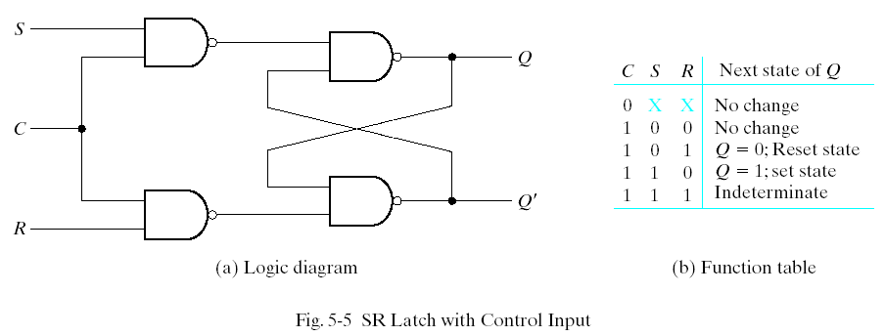
SR Flip Flop
The operation of the basic SR latch can be modified by providing an additional control input that determines when the state of the latch can be changed. it consists of the basic SR latch and two additional NAND gates.

Slide 7
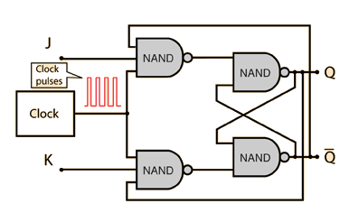
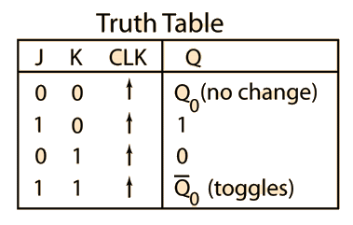
JK Flip Flop
There are three operations that can be performed with a JK flip-flop:
set it to 1,
reset it to 0,
or complement its output.

Slide 8
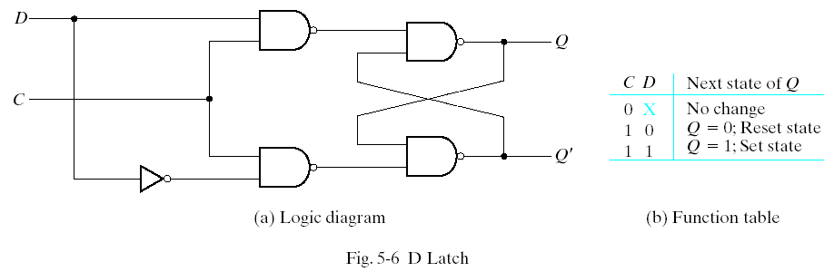
D Flip Flop
One way to eliminate the undesirable condition of the indeterminate state in SRFF is to ensure that inputs S and R are never equal to 1 at the same time. This is done in the D Flip Flop.

Slide 9
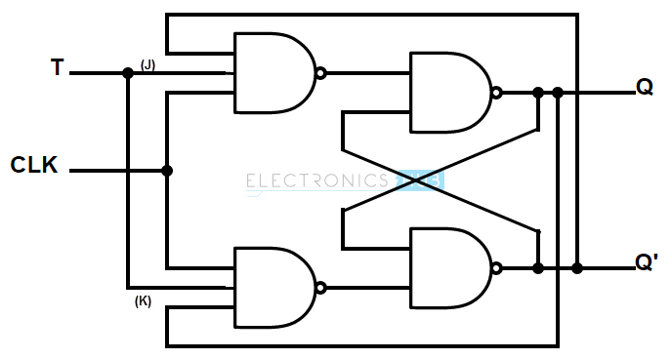
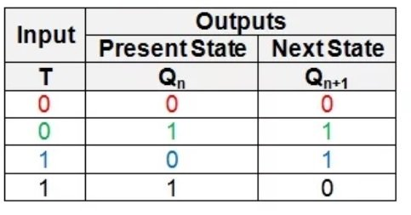
T-Flip Flop
The T(toggle) flip-flop is a complementing flip-flop and can be obtained from a JK flip-flop when inputs J and K are tied together.

Slide 10
Counters
A counter is a sequential circuit that goes through a predetermined sequence of states upon the application of clock pulses.
A counter may count up or count down depending on the input control. The count sequence usually repeats itself.
Types:
Asynchronous counters
Synchronous counters

Slide 11
Asynchronous counter-
The clock signal (CLK) is only used to clock the first FF.
Each FF (except the first FF) is clocked by the preceding FF.
Synchronous counter-
The clock signal (CLK) is applied to all FF, which means that all FF shares the same clock signal.
Thus the output will change at the same time.

Slide 12
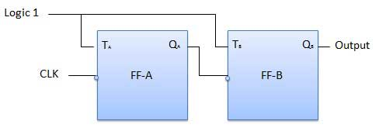
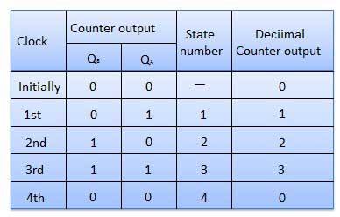
MOD- 4 Asynchronous Counters
A counter with n flip-flops can have 2 to the power n states. The number of states in a counter is known as its mod (modulo) number.
The clock pulse fed into FF0 is rippled through the other counters after propagation delays, like a ripple on water, hence the name Ripple Counter.

Slide 13
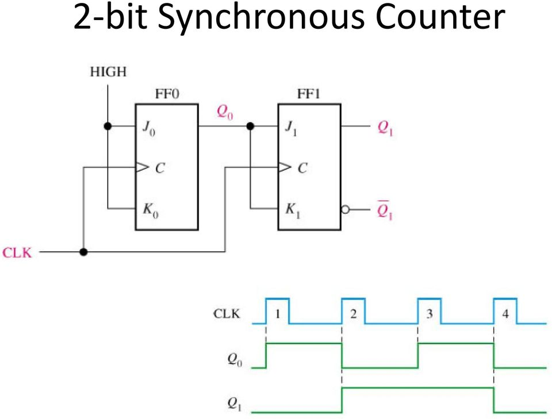
2-bit Synchronous Counter
Synchronous counters are sometimes called parallel counters as the clock is fed in parallel to all flip-flops.

